Slide 1
Amazon-clone
With
React js
Created By : Sudhanshu Vishwakarma

Slide 2
Future scope
Offer a convenient and seamless experience.
(“Make sure your web pages load quickly along with all images”)
Users demand speed.
(“2 seconds is the threshold for e-commerce website acceptability.”)
Make the checkout process and payments faster

Slide 3
Topics ?
Why Amazon clone?
What’s Different in it?
Why coded on react js not in other language?
React-Router-Dom
Firebase Database
Payment Gateway
API Integration

Slide 4
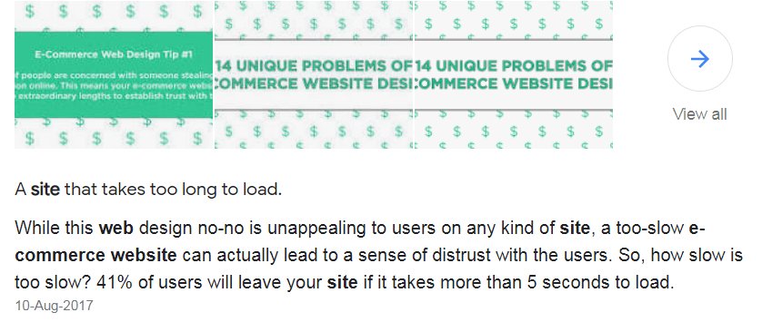
Why?
Amazon-clone
Challenge
User experience fault
Learned new technology

Slide 5
Let’s Watch a short intro video to project.. Notice the loading time

Slide 6
What’s Different in it?
Now This is practical data..
Original amazon.com = app. 39 sec
Amazon-clone = app. 20 sec

Slide 7








language
Amazon.com
Java, C++, Perl
Amazon-clone
React js

Slide 8

Why coded on react js not in other language?

Slide 9
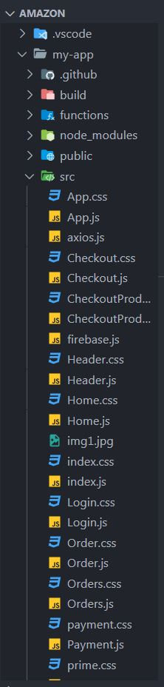
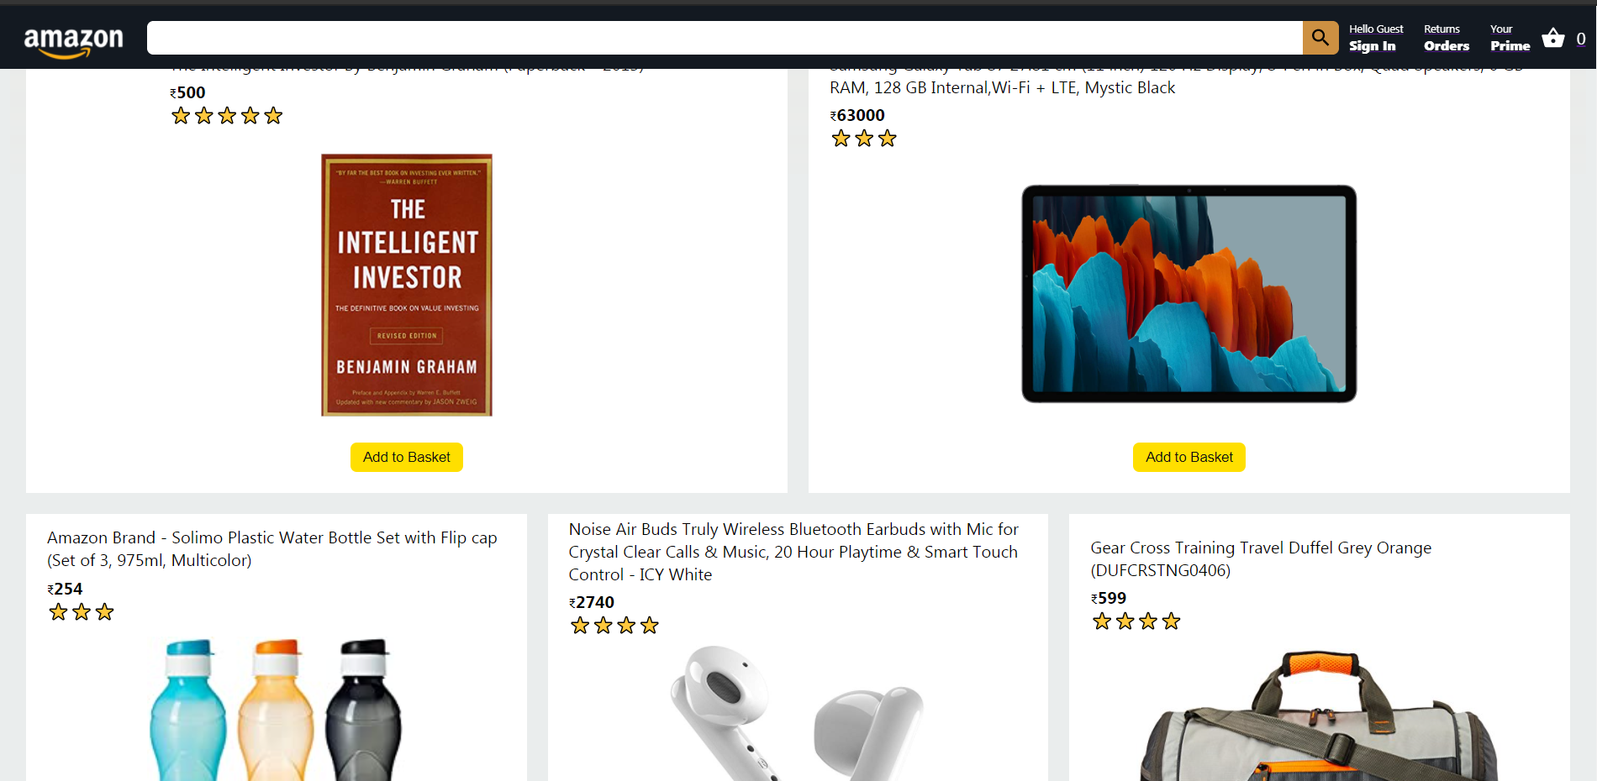
React js
ReactJS is one of the most popular new web frameworks, used by many innovative companies.

Slide 10
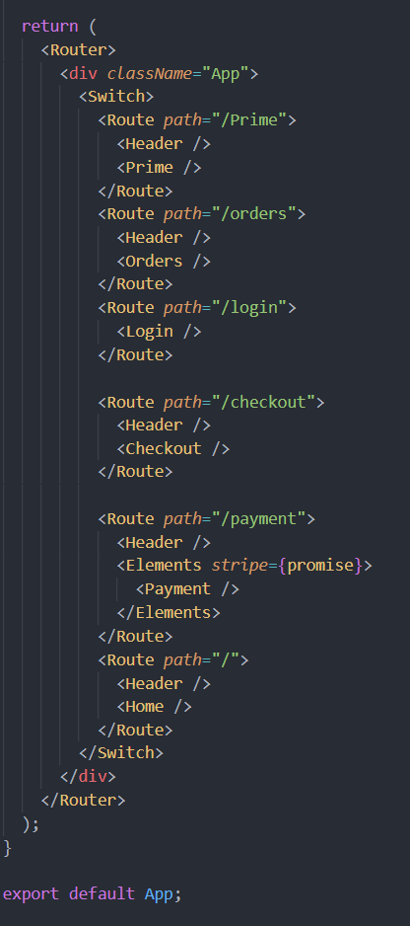
React-Router-Dom
A tool that allows you to handle routes in a web app, using dynamic routing.
import { BrowserRouter as Router, Switch, Route } from "react-router-dom";
Single-page applications (SPAs) rewrite sections of a page rather than loading entire new pages from a server.
Twitter is a good example of this type of application. When you click on a tweet, only the tweet’s information is fetched from the server. The page does not fully reload

Slide 11
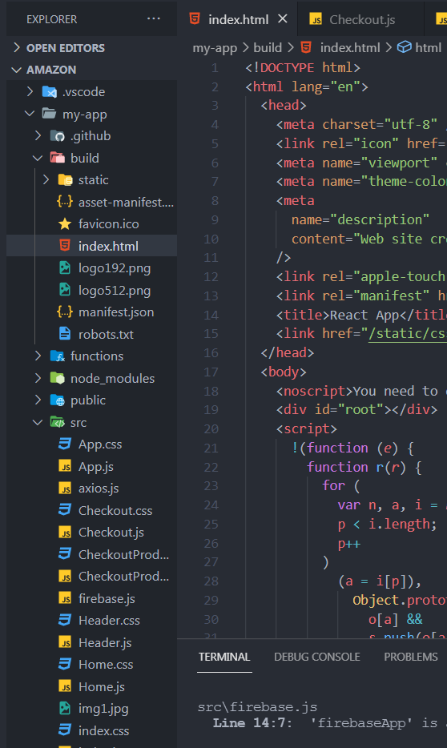
Benefits of React js
It boosts productivity and facilitates further maintenance
It ensures faster rendering
It guarantees stable code
It is SEO friendly
React Router is a great way to build single-page applications because you prevent a page refresh every time a link is clicked. With client-side rendering, the page doesn't refresh as you navigate through the different links.

Slide 12
Amazon-clone(React js)
Firebase
(deployed on firebase)
Global state
Index.html(build)
App.js
Header.js
Home.js
Build in a single html page
Login.js
Order.js
Firebase.js
Product.js
Payment.js

Slide 13
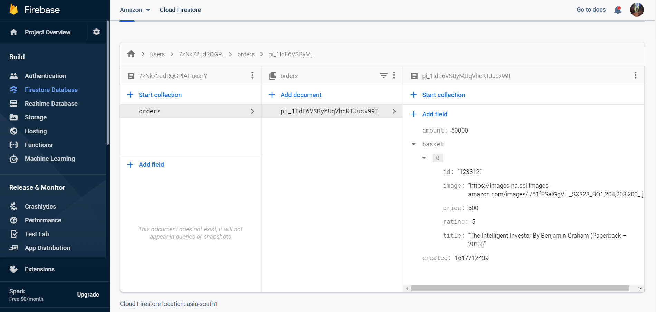
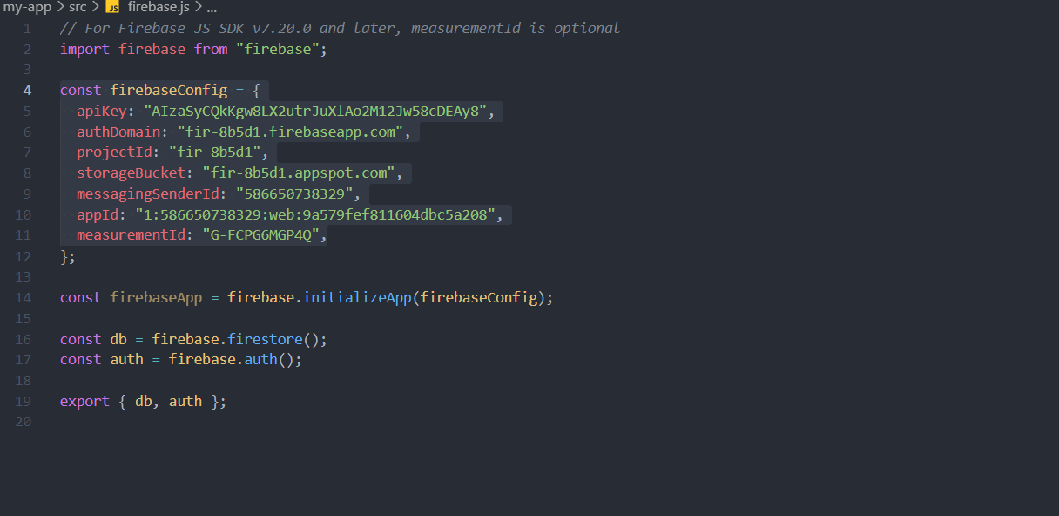
Firebase Database
Firebase is a Backend-as-a-Service (Baas).
It is built on Google's infrastructure.
Firebase is categorized as a NoSQL database program, which stores data in JSON-like documents.

Slide 14
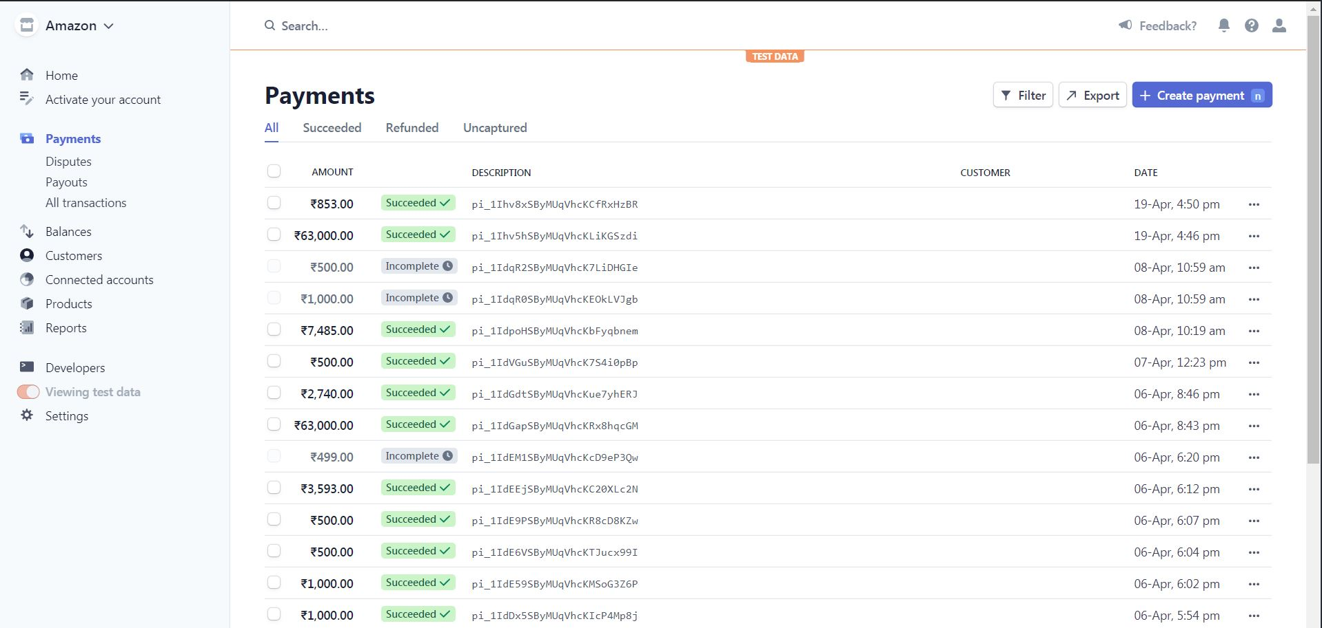
Payment
Gateway
//Recent payments
Stripe is an online payment processing platform that allows businesses to send and receive payments over the internet.
Stripe has some of the world's best companies as their preferred payments processor such as Amazon, Shopify, GitHub, Yelp, Spotify, Uber, TED etc.

Slide 15
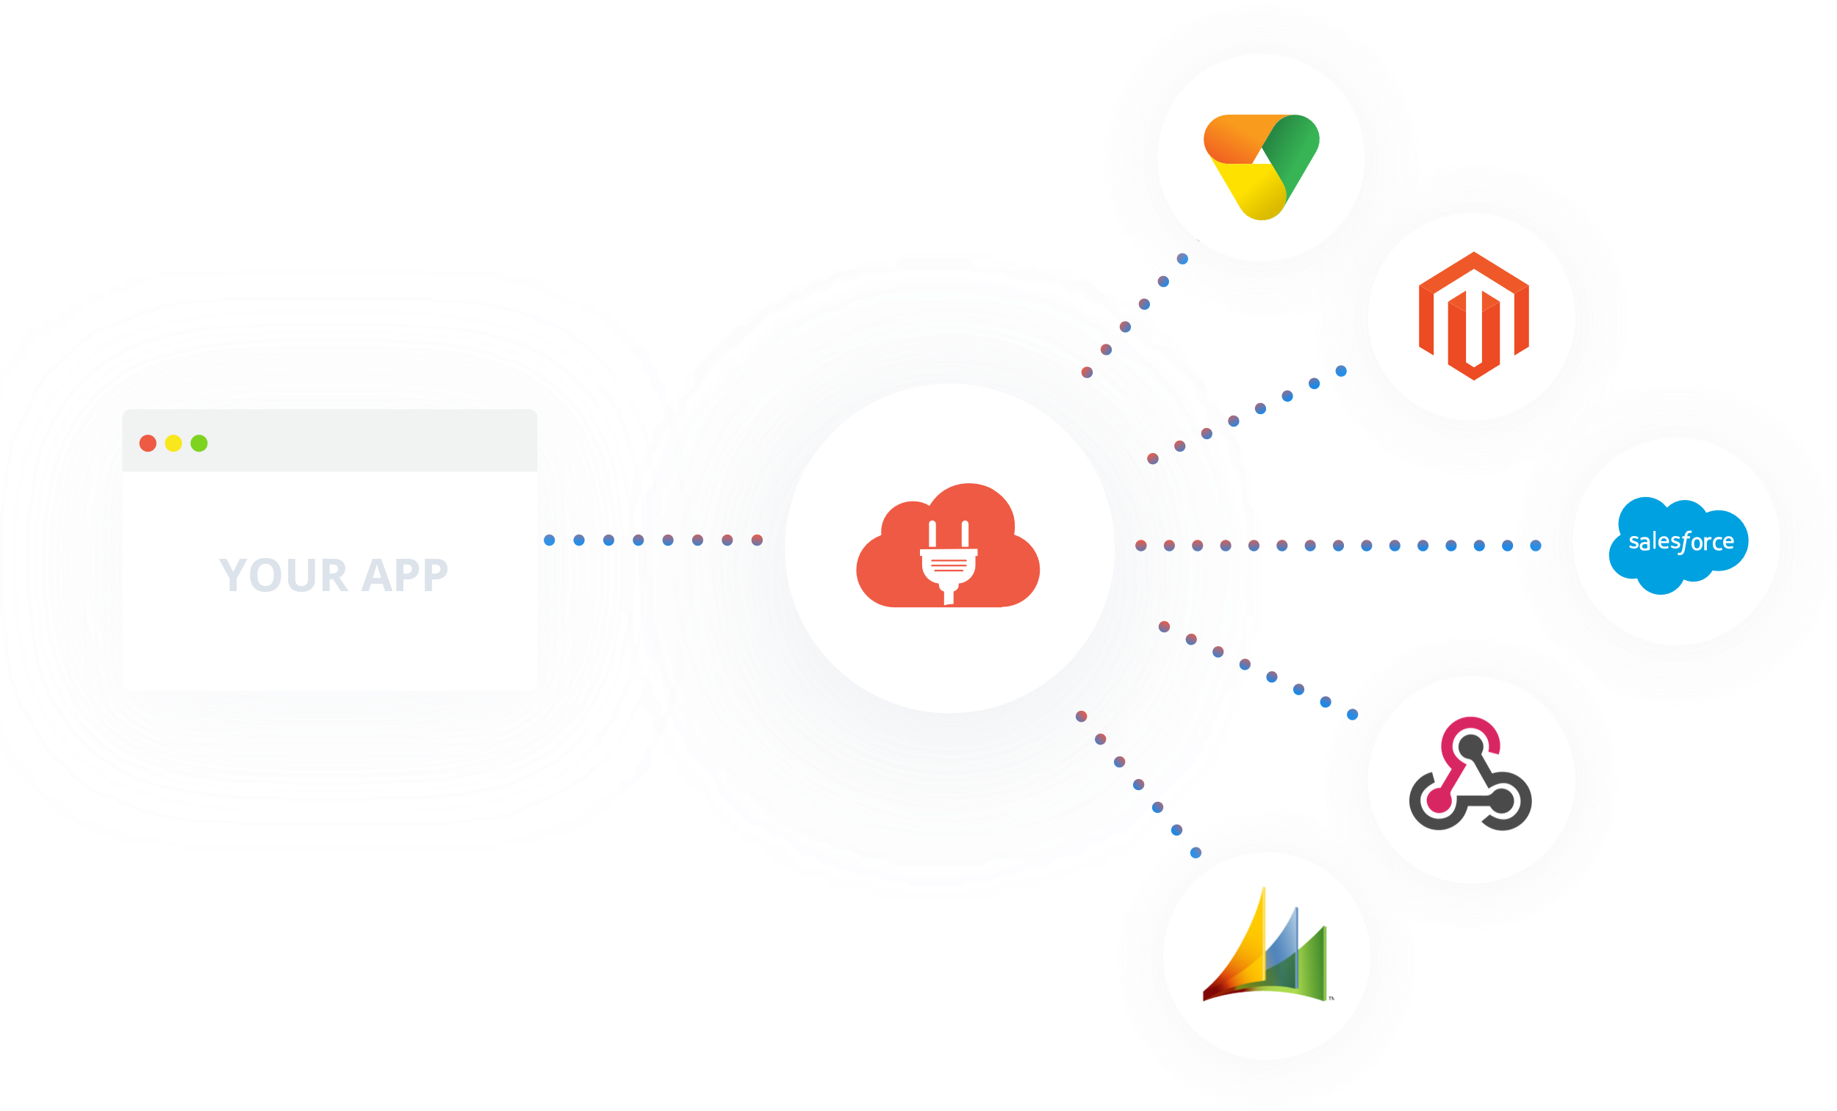
API Integration
An application programming interface (API) is a messenger that processes requests and ensures seamless functioning of enterprise systems.
//connecting apis
Axios is a promise-based HTTP client that works both in the browser and in a Node. js environment.

Slide 16





JavaScript Library used
MATERIAL-UI
React Router DOM
For Database
Payment gateway

Slide 17
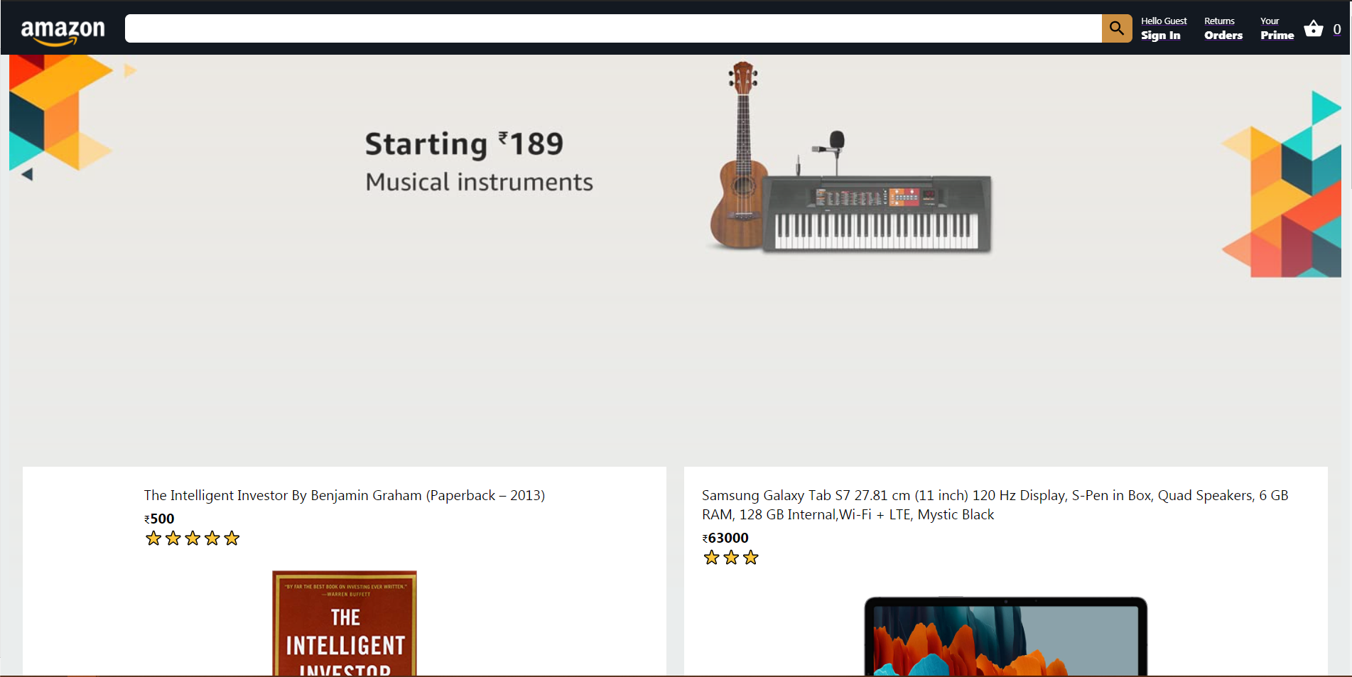
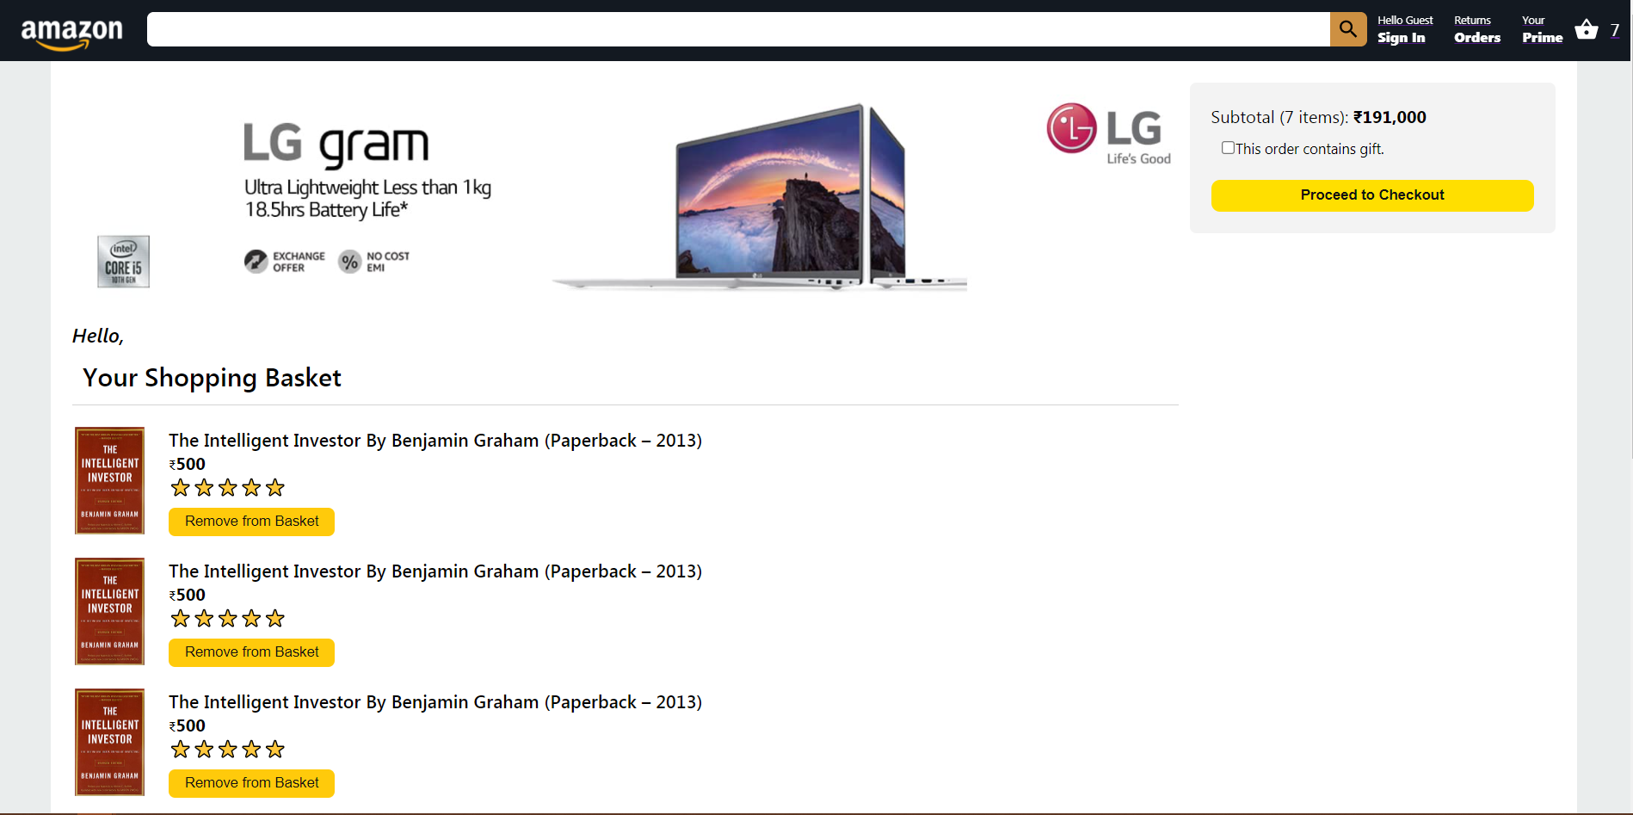
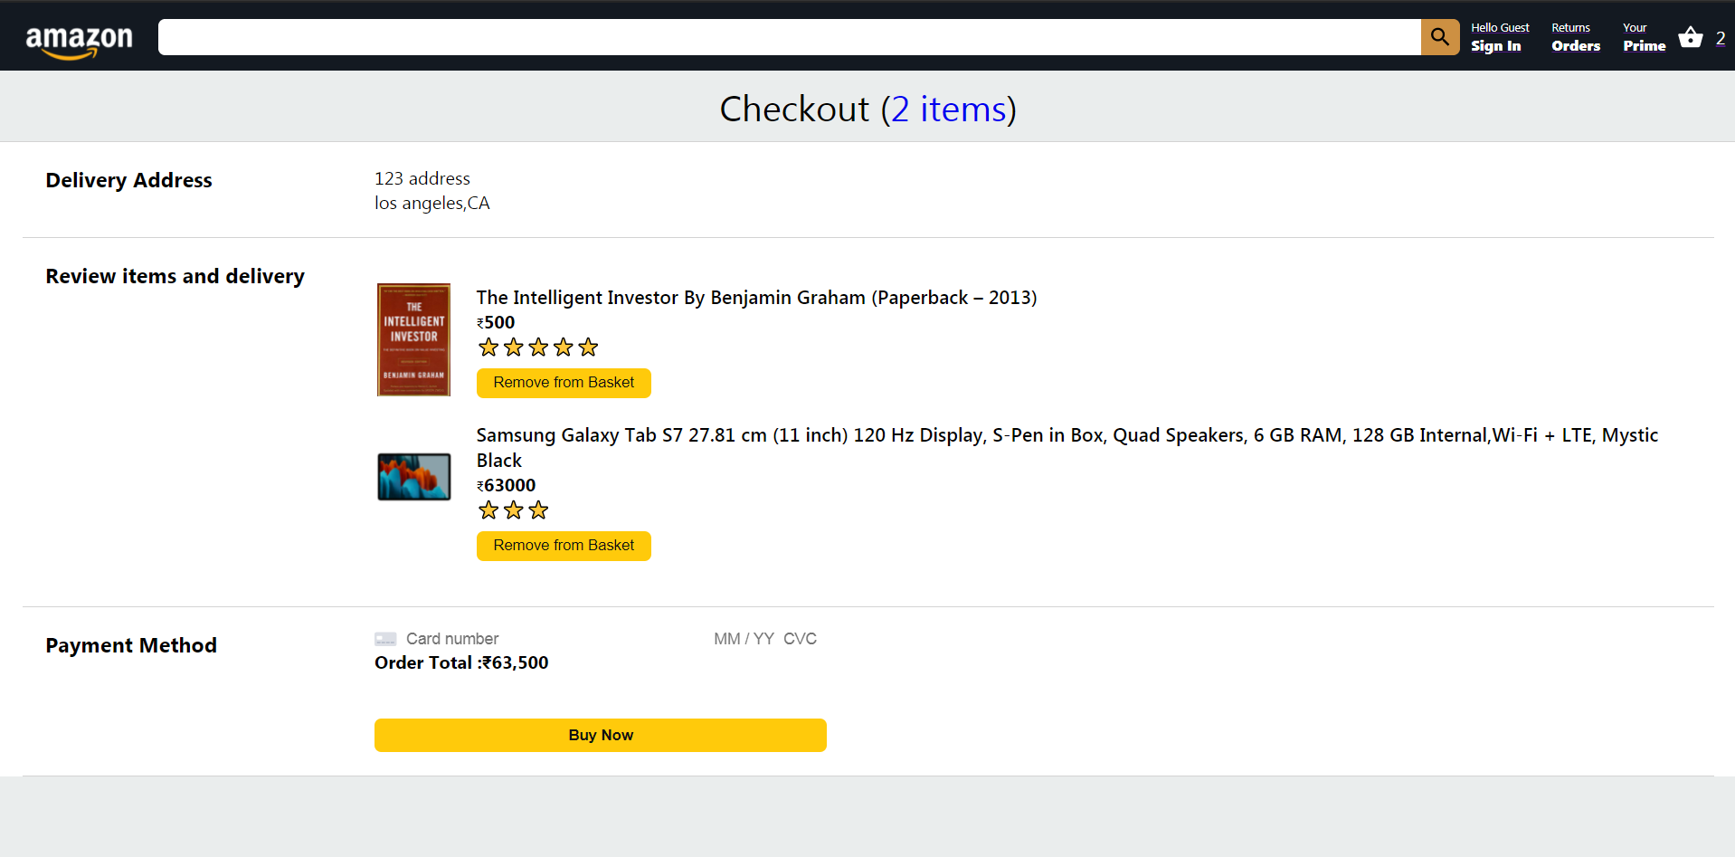
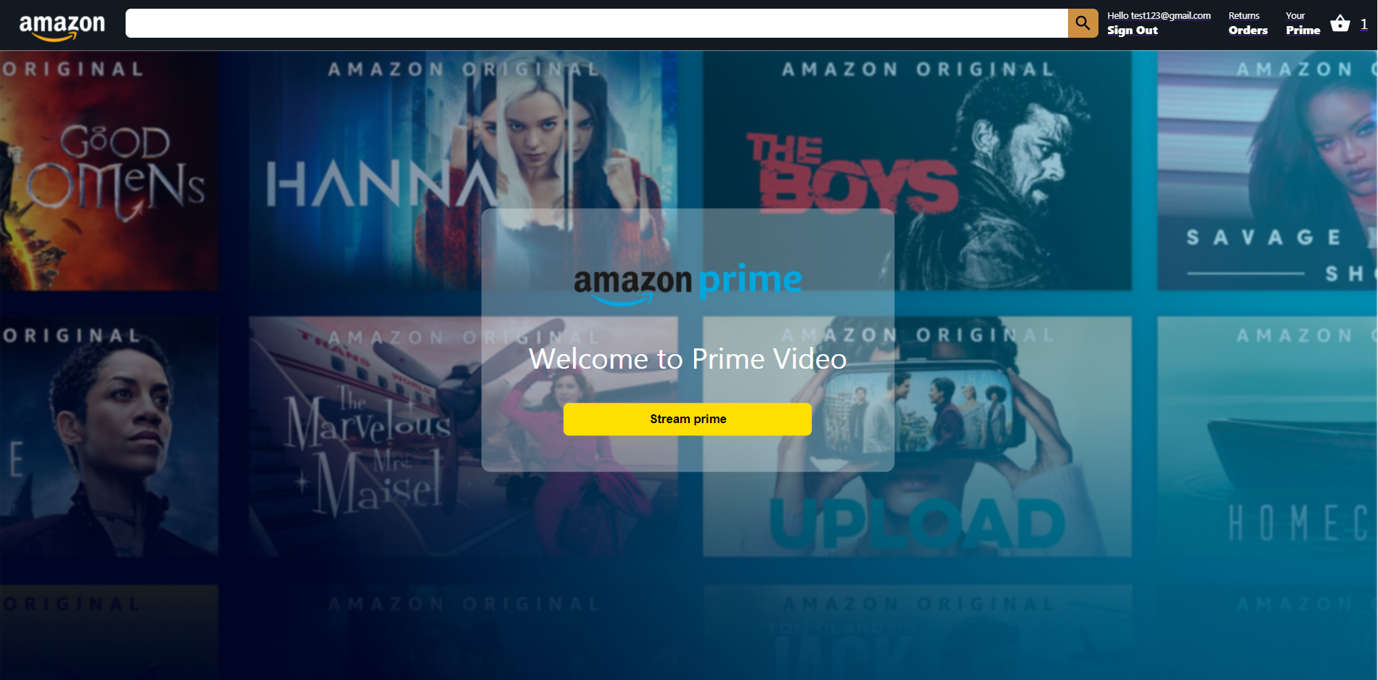
Snap-shots

Slide 18
Thank You!
Stay safe

